Slide 1
AI On Your Phone
@ray_deck
github.com/rhdeck/boscc29

Slide 2
What’s it Good For?

Slide 3
Identification

Slide 4
Generation

Slide 5
Voice

Slide 6
Prediction

Slide 7
Prediction

Slide 8
What is a Machine Learning Model?

Slide 9
Artificial Intelligence Deep Learning Machine Learning Statistical Computing

Slide 10
Supervised Learning Unsupervised Learning Reinforcement Learning

Slide 11
Ops and Numbers
Input Shape
“The Graph”
Conv2D, ReLU, MaxPool, etc…
Output Shape

Slide 12
y = mx + b

Slide 13
Ops
Convolutions
Pooling
ReLU
TanH
Sigmoid
LSTM
GRU
Dense/Fully-Connected
More…

Slide 14
High-Dimensional Numbers

Slide 15
Images are High-Dimensional Numbers!

Slide 16
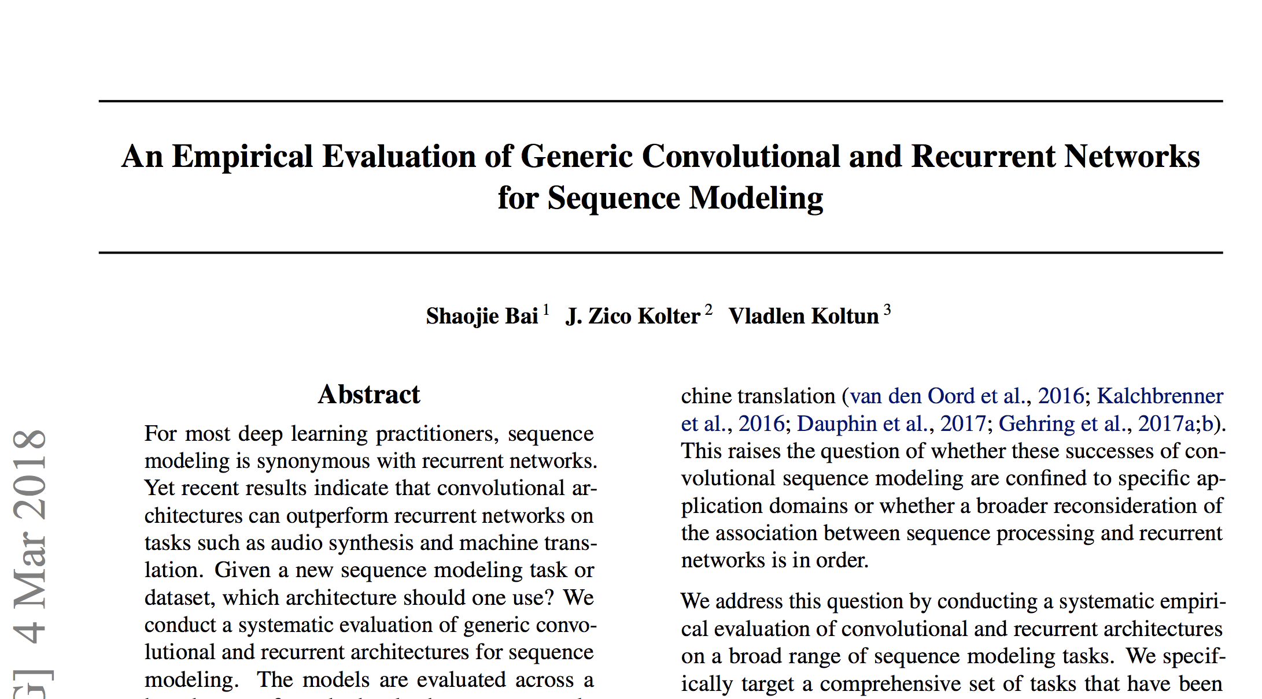
Old Stuff Works
https://arxiv.org/pdf/1803.01271.pdf

Slide 17
Packaging

Slide 18
Models (Can Be) Files
Shapes of Input(s)
Operations
Hyperparameters
Weights
Sources & Drains
Shapes of Output(s)

Slide 19
What Do we Need?
Convert Image/Frame to Normalized Number
Run the model efficiently on local resources
Convert output number to what we seek:
Dictionaries of labels
Generated Image
Prediction
etc

Slide 20
Lite

Slide 21
ML Universe
Cloud
Azure, Amazon, Google, MachineBox…
…plus MacGyver, Algorithmia…
Train
Inference
Tensorflow, Theano, CNTK…
…CoreML, TF Lite, TF Mobile, TF.JS Caffe Lite
Local

Slide 23
iOS Runtime and Bindings
File Format
Conversion Tooling

Slide 24
Runtime and Bindings
CVPixelBuffer in, Dictionary Out
Support for OTA/Runtime Download and Compilation
Uses Metal Shaders for processing
Limited Operation Support

Slide 25
.mlmodel
Protobuf
Feature Normalization
Value Range of Numbers (0-255 -> 0-1)
Mean Value
Channel Ordering
BGR vs RGB
Output Labeling/Denormalization

Slide 26
Conversion
Keras – coremlconverter
Tensorflow – tf-coreml
CNTK - mmdnn
MXNet – mxnet-to-coreml

Slide 27
Advantages
Ease of Application
Speed Multiple analyses per second
Separation of Concerns Compilation vs Inference
Source Agnostic

Slide 29
Multiple Runtimes
File Format
Converter
Lite

Slide 30
Cross-Platform
iOS, Android, Raspberry Pi
feed() and run()
No Compilation Step
Limited Operations
Number-to-Number
Lite

Slide 31
.tflite
FlatBuf
Quicker Memory Access
Alternative Precision: Bfloat16
Lite

Slide 32
Conversion
toco Tensorflow Optimizing Converter
Lite

Slide 33
iOS Only | Multiplatform
Input/Output Affordance | Just the Numbers
Production | Beta
Chunky | Small

Slide 34
Cross-Platform Optimizations

Slide 35
Quantization

Slide 36
Pruning

Slide 37
Planning
VGG16 550MB
InceptionV3 94MB
MobileNet 17MB

Slide 38
One More Thing

Slide 40
WebGL
Functional Programming
Cross-Platform Nirvana?

Slide 41
@ray_deck
github.com/rhdeck/boscc29

